Slide 1
EE 123 Final Project
By: Henry Leou, Sheng-Yu Wang, James Park, Johnny Wang

Slide 2
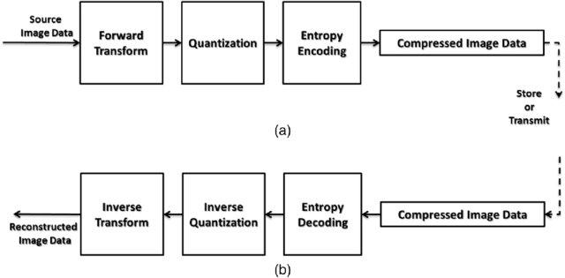
Workflow - JPEG2000

Slide 3
What we’ve tried
Residuals (frame differences)
Transformation:
RGB -> YCrCb
Downsample / Upsample using FFT
Wavelet w/ DB-4
Quantization w/ Threshold
LZMA compression
Video post processing - Bilateral filtering
Tried utilizing the digipeater field in order to store more information
Modify the AX 25 protocol

Slide 4
What we’ve found

Slide 5
Downsampling v.s. Quantization
Result on Andy
Downsampling (same for all channels) | Quantization (same for all channels) | LZMA Compression Ratio (Y/Cr/Cb) | PSNR
1 | 16 | 96 / 395 / 488 | 26.427
0.85 | 16 | 84 / 361 / 439 | 25.887
0.7 | 16 | 75 / 316 / 378 | 24.923
0.4 | 16 | 51 / 194 / 228 | 22.68
0.1 | 16 | 27 / 44 / 46 | 19.29
Notes:
Due to the transmission constraint, downsampling and quantization is the two main source of size reduction. We found out finding the right combination of downsampling and quantization will leads to the best compression/quality tradeoff
Here are some combinations we tried on xxx.png. If the downsampling is too intense, the advantage of sparsity from wavelet will not be as effective.

Slide 6
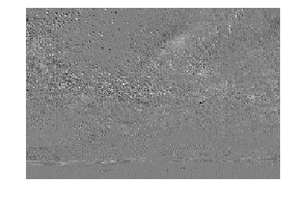
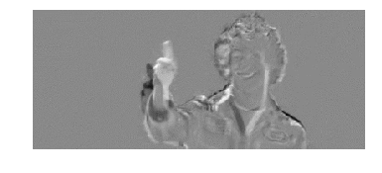
Residuals or not?
Difference image - sparsity for free
Andy
Milky way

Slide 7


Residuals or not?
Disadvantage : error propagates when adding back the residuals
Notes:
milkyway:
python3 wavelet/wavelet_encode.py -i milkyway.png -o test.p -y 0.8 -c 0.6 --level 3 --tf_y_dc 5 --tf_r_dc 5 --tf_b_dc 5 --tf_y_rs 5 --tf_r_rs 5 --tf_b_rs 5;
8.4kb;
Psnr: 18.04

Slide 8


Bilateral filter
PSNR: 23.65
PSNR: 24.04
Notes:
w/o bilateral: 23.64638171223945
w/ bilateral: 24.03933377913863

Slide 9
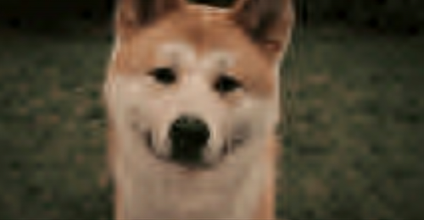
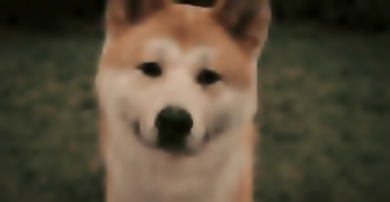
Bilateral filter
PSNR: 28.87
PSNR: 29.32
Notes:
w/o bilateral: 28.86867699054242
w/ bilateral: 29.327623163875522

Slide 10
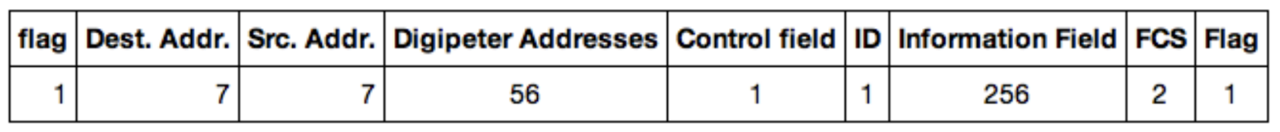
Digipeater
Reduce overhead by sending information in digipeater as well.
Observed 0.9 transmission time reduction if sent 56 bytes in digipeater.
Useless bytes: 1+7+7+1+1+2+1 + digipeater = 20+ bytes per packet

Slide 11
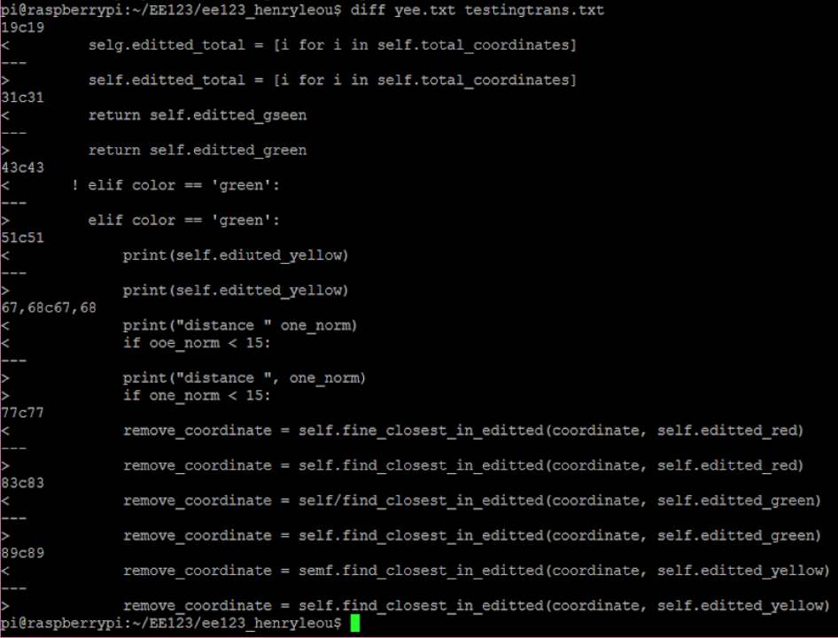
Digipeater
Notes:
We tried using the digipeater scheme to send an image but the resulting image was corrupted. In order to debug, we sent a text file and observed the differnce. This image is the difference between the original text file and the decoded file from our digipeater scheme. As you can see, there are some corroputed character such as on the top the f in self becomes g and the r in green becomes s. We weren’t able to fix this bug but we observed that these corrupted charactors all happen right between the junction of digipeater filed and information field.

Slide 12


Best results
File Size: 6.1KB; PSNR: 24.04 (Baseline: 19.57)
Ours
Ground Truth
BaseLine
Notes:
python3 wavelet/wavelet_encode.py -i simpson.png -o test.p -y 0.88 -c 0.88 --level 3 --tf_y_dc 5 --tf_r_dc 5 --tf_b_dc 5 --tf_y_rs 4.5 --tf_r_rs 4.5 --tf_b_rs 4.5 (bilateral , 7, 50, 50) 6.1KB; psnr: 24.03933377913863

Slide 13
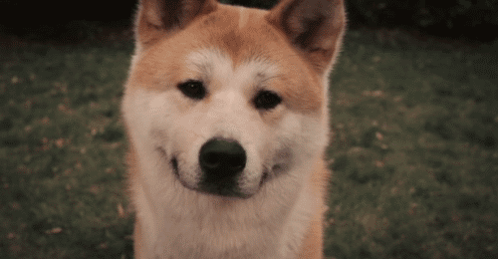

Best results
File Size: 6.5KB PSNR: 29.33 (Baseline: 26.85)
Ours
Ground Truth
BaseLine
Notes:
python3 wavelet/wavelet_encode.py -i dog.png -o test.p -y 0.85 -c 0.85 --level 3 --tf_y_dc 5 --tf_r_dc 5 --tf_b_dc 5 --tf_y_rs 4.5 --tf_r_rs 5 --tf_b_rs 5 (bilateral 13, 75, 75) 6.5KB; psnr: 29.327623163875522

Slide 14


Best results
File Size: 6.6KB PSNR: 25.89 (Baseline: 22.37)
Ours
Ground Truth
BaseLine
Notes:
python3 wavelet/wavelet_encode.py -i Andy_Video.png -o test.p -y 0.85 -c 0.85 --level 3 --tf_y_dc 5 --tf_r_dc 5 --tf_b_dc 5 --tf_y_rs 5 --tf_r_rs 5 --tf_b_rs 5; 6.6KB; psnr:25.887413184854346
Andy

Slide 15
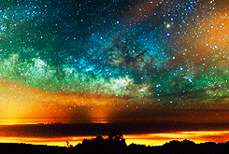


Best results
File Size: 6.4 KB PSNR: 18.26 (Baseline: 17.36)
Ours
Ground Truth
BaseLine
Notes:
The result is the most challenging result...
python3 baseline_decode/baseline_encode.py -i milkyway.png -o test/milk.p -y 0.195 -c 0.1 --y_scale 16 --c_scale 16 --no_residual (bilateral 13, 75, 75)
File size: 6.4 KB
Psnr: 18.25

Slide 16
Contribution
We’ve contributed equally.

